Slide 1
Project Title :-
SMART GROCERY SHOPPING ASSISTANT WITH BASKET ANALYSIS
Team members :- K. ROSHINI
K.SATHVIKA
I.KARTHIK
K.SRINIVASA CHARY

Slide 2
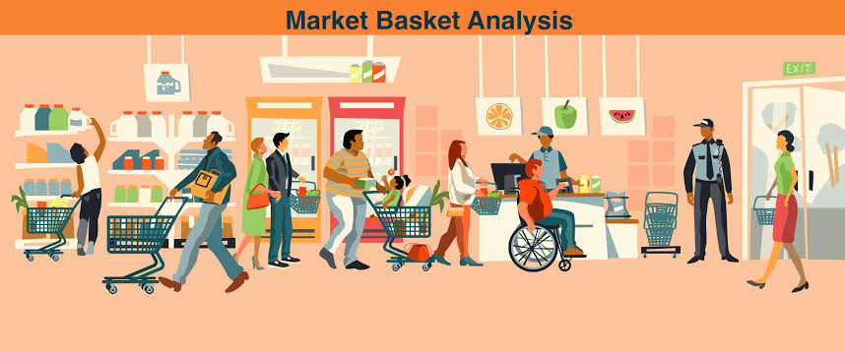
INTRODUCTION
Retailers employ the data mining approach of market basket analysis to gain insight into their consumers' shopping habits. It is determining which products are regularly bought in tandem with one another.

Slide 3
Market Basket Analysis
• A data mining method called market basket analysis is used to find connections between products that are regularly bought together in transactions. Market basket analysis, sometimes referred to as association analysis or affinity analysis, looks for associations or patterns of co-occurrence between the products that consumers purchase.

Slide 4
Purpose
The purpose of a Smart Grocery Shopping Assistant with Basket Analysis is to enhance the grocery shopping experience for consumers and optimize operations for retailers.It includes
Personalized Shopping Experience
Efficient Shopping lists
Budget Management
Healthier Choices
Optimized Inventory Management
Targeted Marketing and Promotions

Slide 5
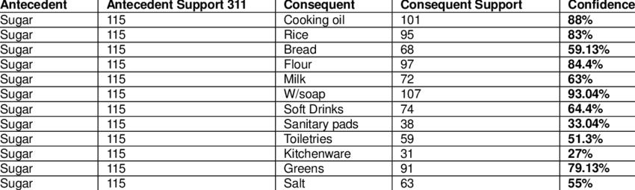
STEPS FOLLOWED
DATA PREPARATION
Before running Market Basket Analysis, ensured data is properly formatted.
Transaction data in a tabular format with each row representing a transaction and columns representing items purchased.

Slide 6
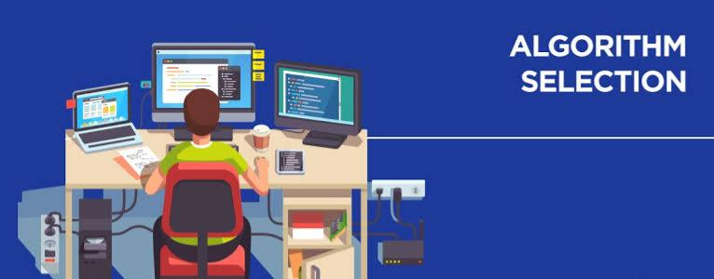
STEPS FOLLOWED
ALGORITHM SELECTION
Apriori Algorithm: Popular for its simplicity and efficiency in finding frequent item sets.
The Apriori algorithm is a classic algorithm used for association rule mining in transactional databases. It is designed to discover frequent item sets within a dataset and generate association rules based on these item sets. The algorithm is widely used in market basket analysis and other applications where the goal is to uncover relationships between items in transactions.

Slide 7
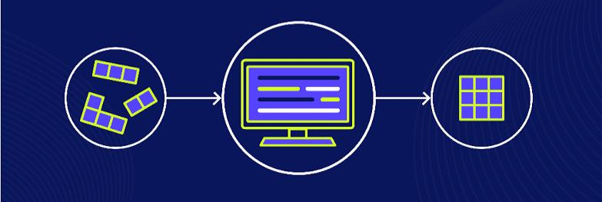
STEPS FOLLOWED
ASSOCIATE RULE MINING
Perform association rule mining on your dataset.
Set minimum support and confidence thresholds.
Identify frequent itemsets and generate association rules.
Interpret the results to derive meaningful insights

Slide 8

IMPLEMENTATION
Demonstrate how to implement Market Basket Analysis using code snippets or examples. Python with libraries like mlxtend or pandas.

Slide 9
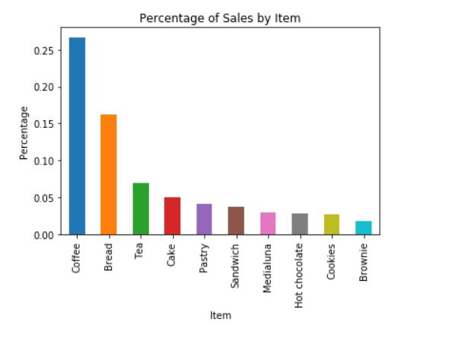
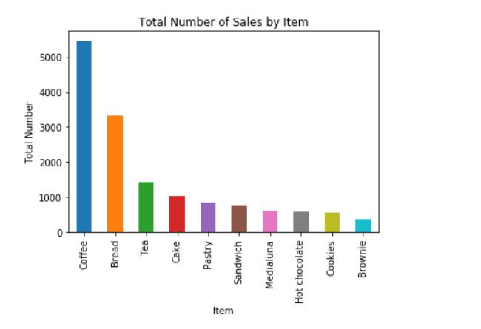
OUTPUTS
The Bar Graph Shows the Most Sold Items From the Top 10 items from the Data set .

Slide 10
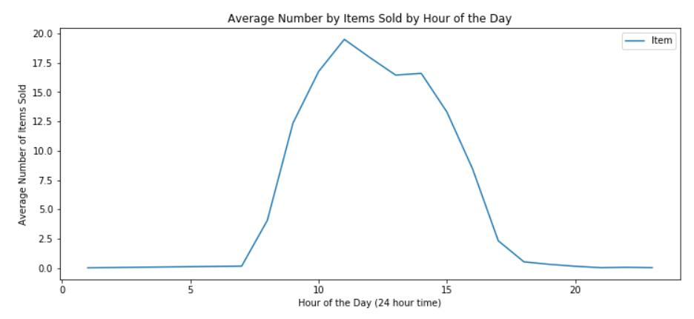
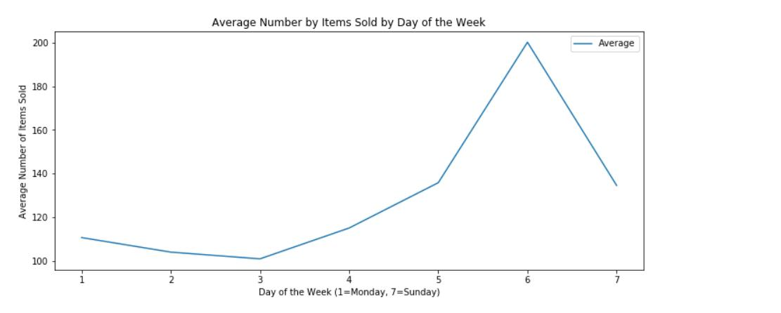
OUTPUTS
The Graph Shows the Average Number of items sold by Hour of the day and Day of the week.

Slide 11
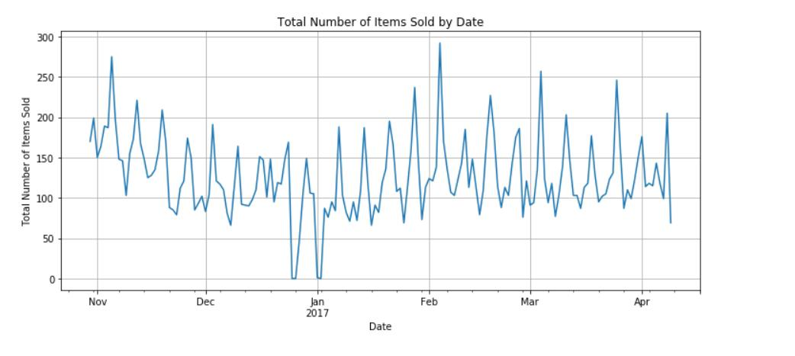
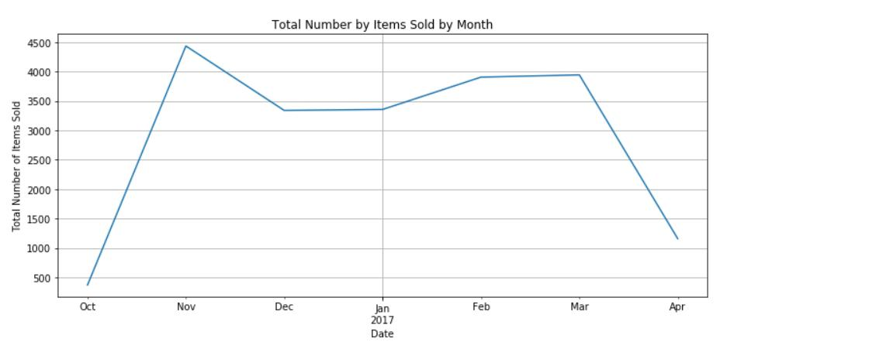
OUTPUTS
The Graph Shows Total Number of items sold By Date and The Total no of items sold by Month.

Slide 12
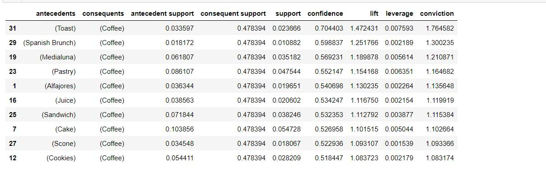
OUTPUTS

Slide 13
APPLICATIONS
Cross Selling and Upselling
Inventory Management
Promotion Planning
Store Layout and Product Placement
E-Commerce Recommendations
Supply Chain Optimisation
Customer Segmentation
Fraud Detection

Slide 14
THANK
YOU

